Slide 1
Stock Portfolio selection by interest
By: Cory Graciano, Jaime Barragan, Morgan Williams

Slide 2
Hypothesis/Question
Our initial goal was to utilize analysis within jupyter notebook to build a functioning input by the user which via a dropdown that compares 3 choices of “portfolios” or groups of pre-selected stock names that are grouped by a common theme
For example, our first portfolio’s theme was based around travel stocks which share the theme of taking a vacation in a tropical setting, hence the name “Tropical Paradise”

Slide 3
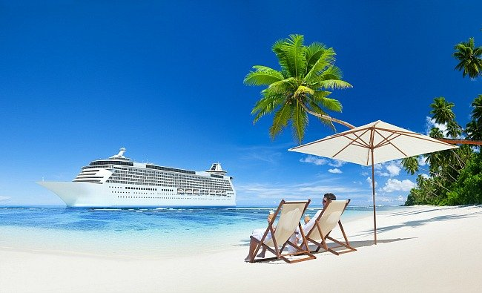


What we analyzed
The three names of the “portfolios” we chose to focus on for this exercise are
Tropical Paradise
Gaming the Edge
Digital Exchange

Slide 4
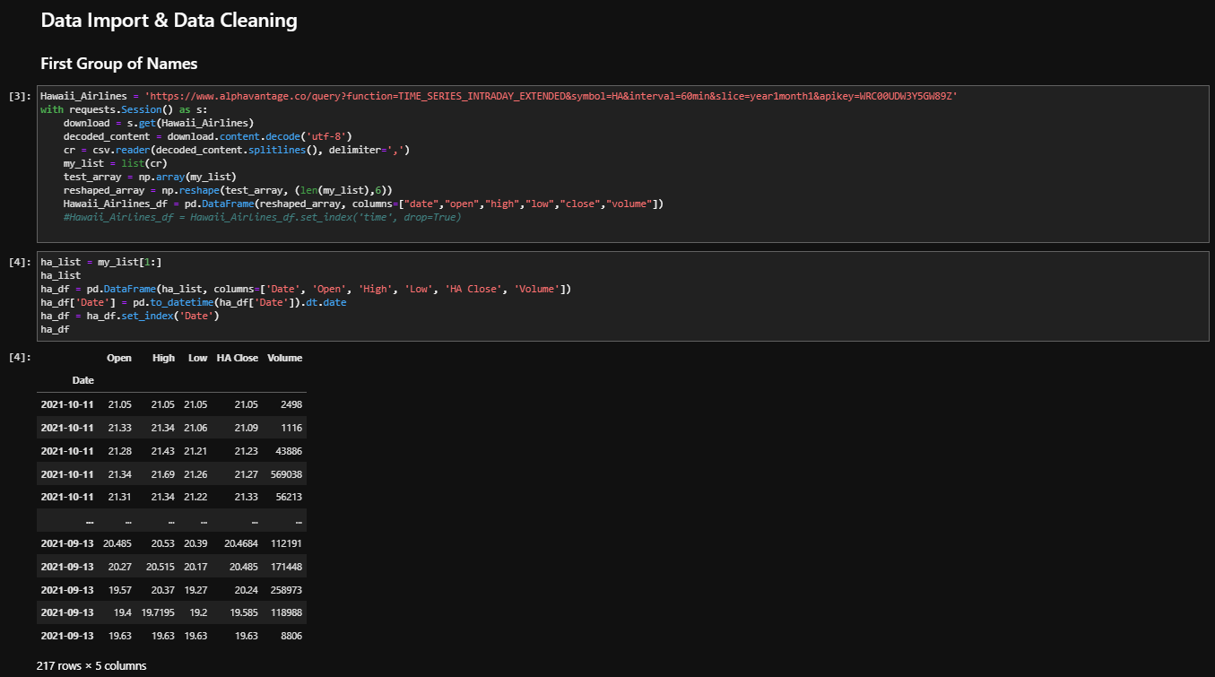
Data import Method and Cleaning Example
API of Choice:
Initially: Alphavantage
Revised: Yahoo Finance
Timeframe of Analysis, daily close = Past 12 Months
Only 3 names in each portfolio

Slide 5
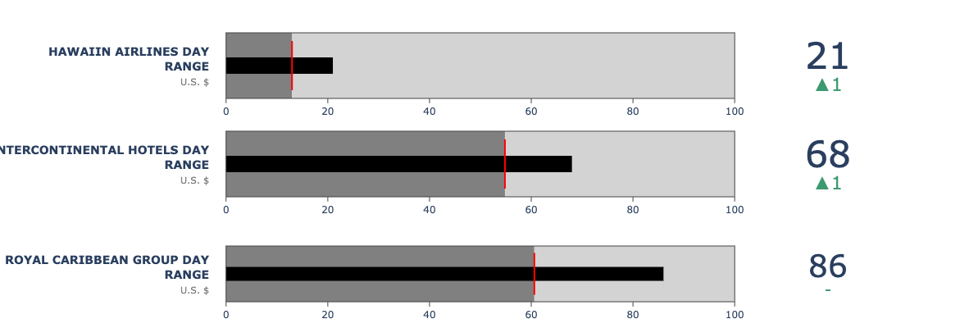
Tropical Paradise Stocks
Hawaiin Airlines
INTERCONTINENTAL HOTELS
ROYAL CARIBBEAN GROUP

Slide 6
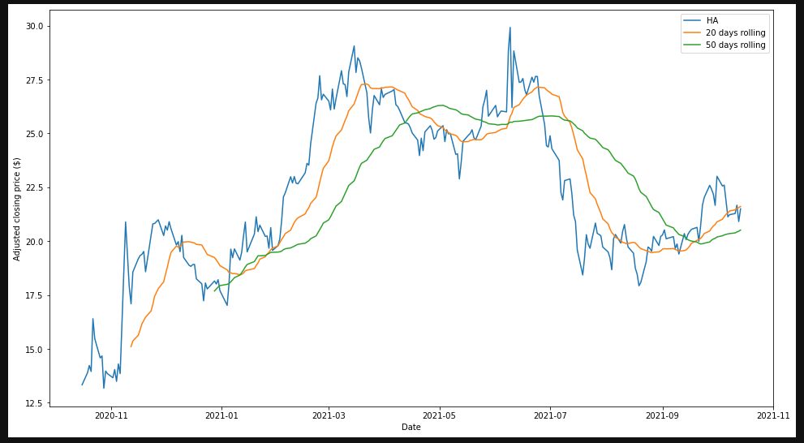
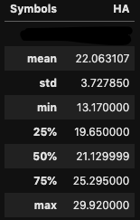
Tropical Paradise Stocks
Hawaiin Airlines
CEO – Peter R. Ingrem
Founded in 1929
Market Cap – 1.14B
52-Week Min - 13.17
52- Week Max – 29.92
Similar Stocks – AA, LUV, DAL

Slide 7
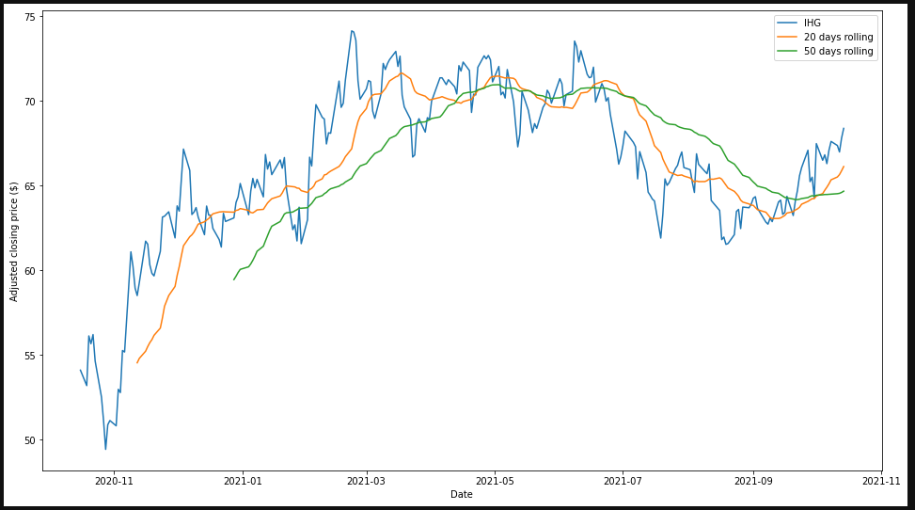
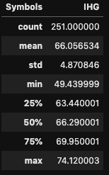
Tropical Paradise Stocks
INTERCONTINENTAL HOTELS
CEO – Keith Barr
Founded 2004
Market Cap – 12.48B
52-Week Min – 49.43
52-Week Max – 74.12
Similar Stocks – DIS, CCL

Slide 8
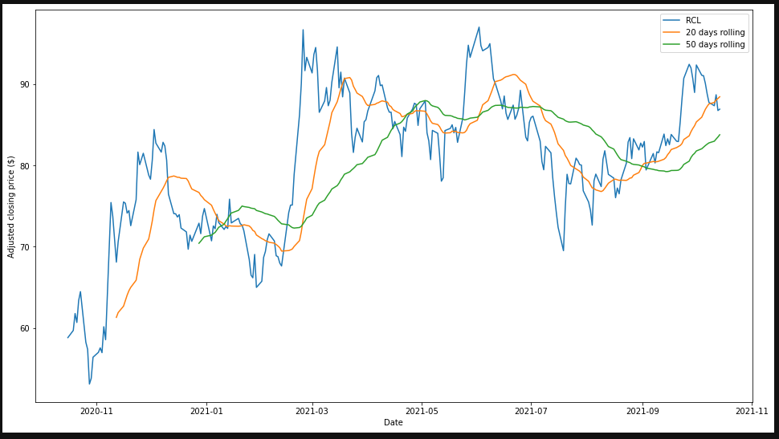
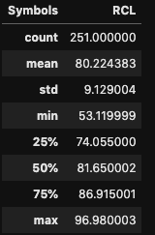
Tropical paradise Stocks
ROYAL CARIBBEAN GROUP
CEO – Richard D. Fain
Founded – 1968
Market Cap – 22.62B
52 – Week Min – 53.11
52- Week Max – 96.98
Similar Stocks – CCL, NCLH

Slide 9
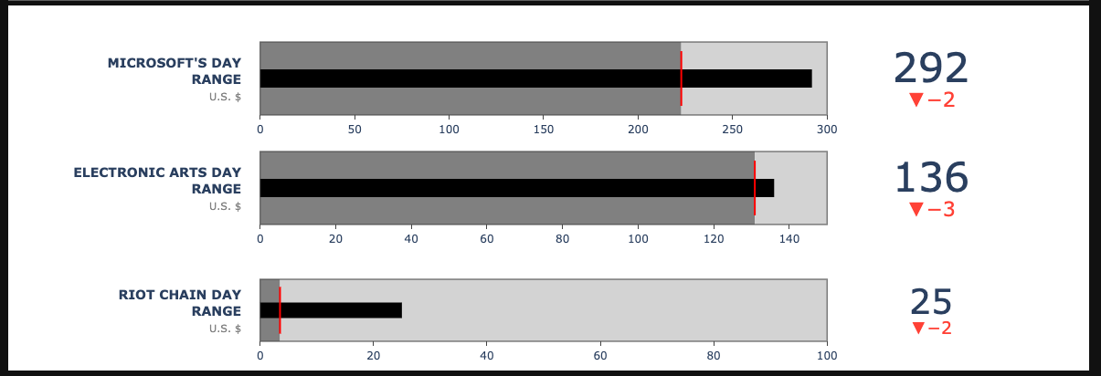
Gaming Stocks
Electronic Arts
MICROSOFT
RIOT BLOCKCHAIN

Slide 10
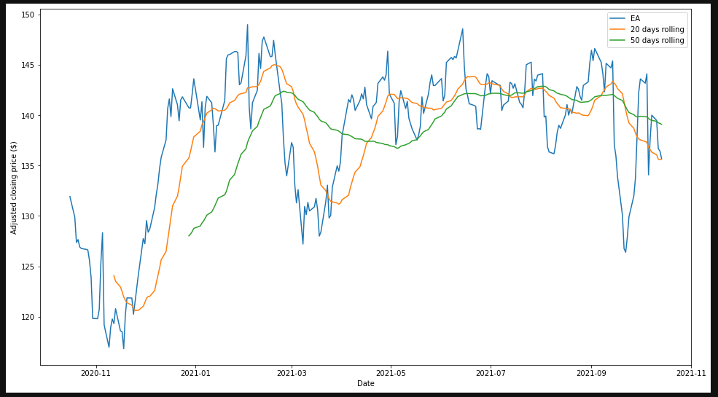
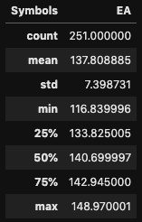
GAMING STOCKS
ELECTRONIC ARTS
CEO – Andrew p. Wilson
Founded – 1982
Market Cap – 38.69B
52 – Week Min – 116.83
52- Week Max – 148.97
Similar Stocks – ATVI, NTDOY

Slide 11
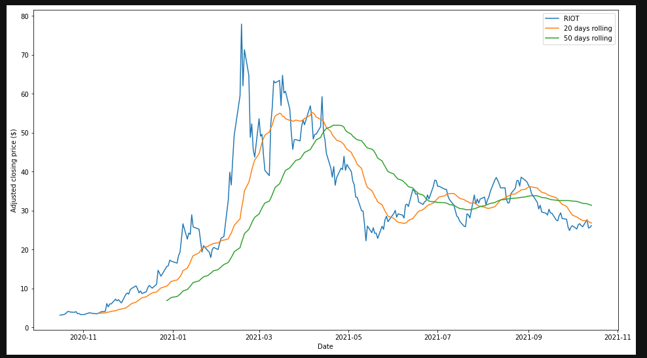
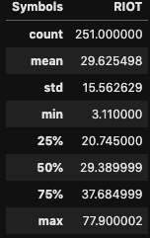
Gaming Stocks
RIOT BLOCKCHAIN
CEO – Jason Les
Founded – 2000
Market Cap – 2.51
52 – Week Min – 3.11
52- Week Max – 77.90
Similar Stocks – MARA, BTBT

Slide 12
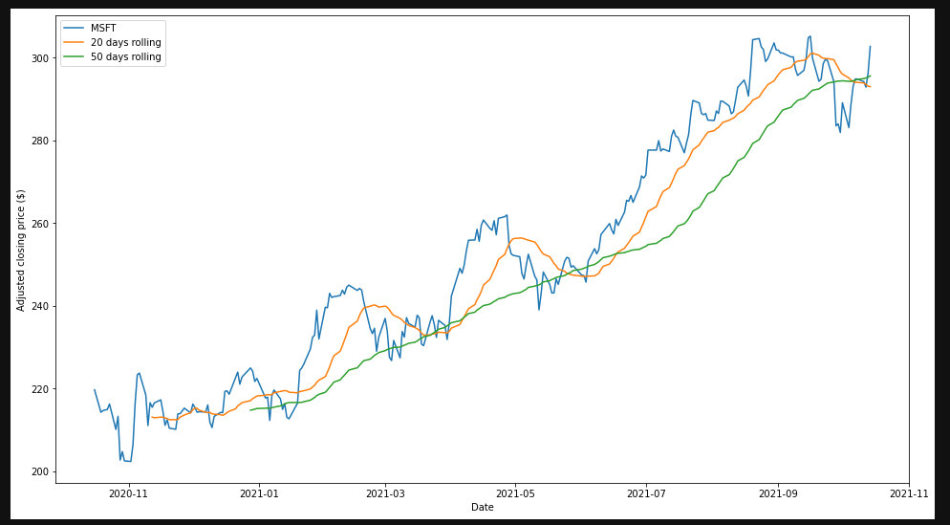
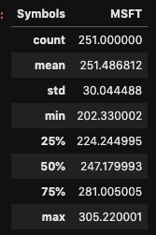
Gaming Stocks
MICROSOFT
CEO – Satya Nadella
Founded – 1975
Market Cap – 2.28T
52 – Week Min – 202.33
52- Week Max – 305.22
Similar Stocks – AAPL, FB

Slide 13
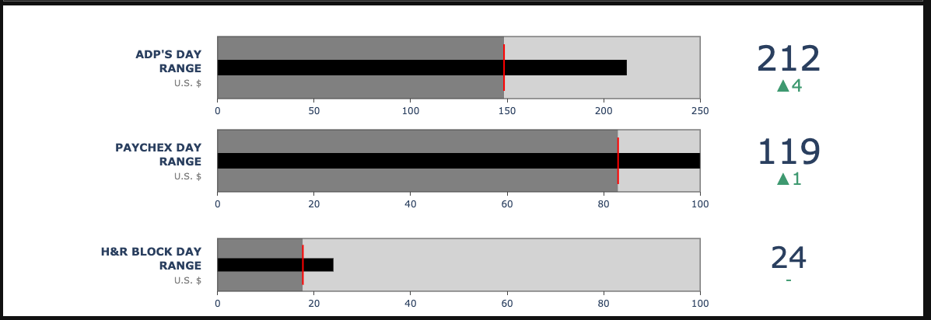
Make the world turn
Automatic Data Processing
H&R Block
PAYCHEX

Slide 14
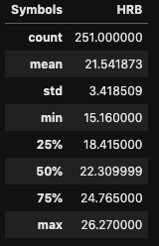
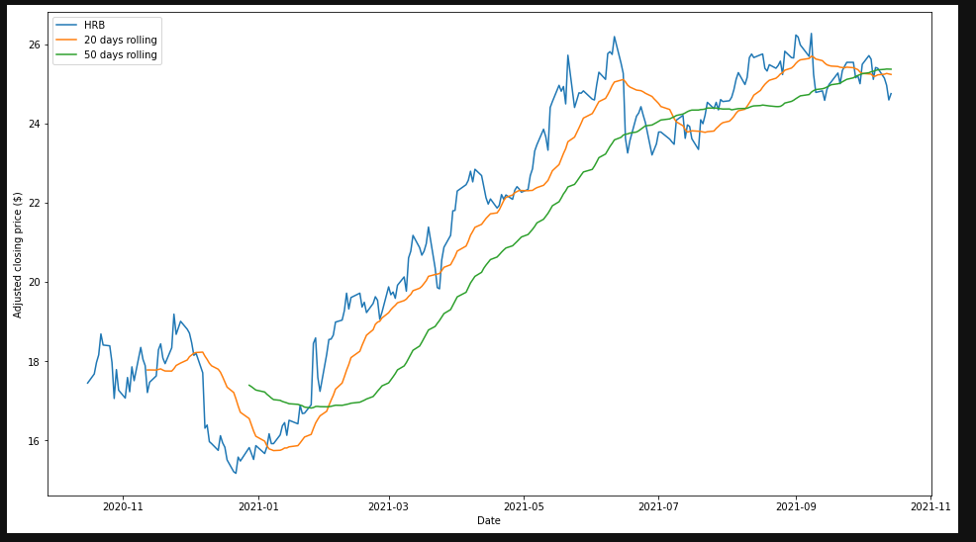
Make the world turn
H&R BLOCK
CEO – Jeffrey J. Jones
Founded – 1955
Market Cap – 4.47B
52 – Week Min – 15.16
52- Week Max – 26.27
Similar Stocks – INTU, SQ

Slide 15

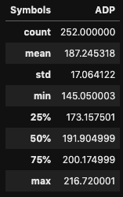
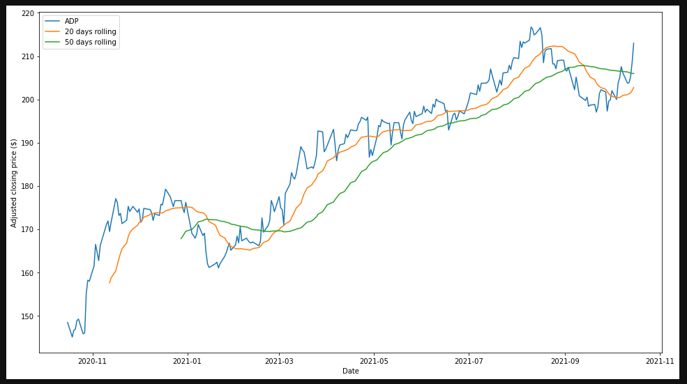
Make the world turn
Automatic Data Processing
CEO – Carlos A. Rodriguez
Founded – 1949
Market Cap – 90.03B
52 – Week Min – 145.05
52- Week Max – 216.72
Similar Stocks – CRM, SHOP

Slide 16
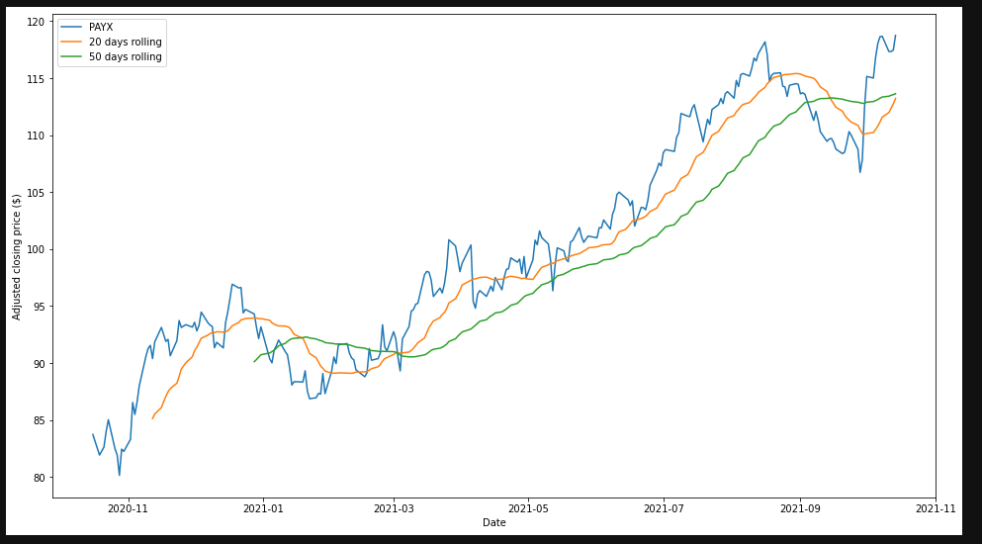
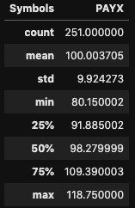
Make the world Turn
PAYCHEX
CEO – Martin Mucci
Founded – 1971
Market Cap – 42.82B
52 – Week Min – 80.15
52- Week Max – 118.75
Similar Stocks – V, MA

Slide 17
Limitations/Early Revisions
Our original plan was to incorporate a scanner that would match “key”words to a predefined stock portfolio selection as an input, but due to our very limited experience in coding, we were forced to select three names for each portfolio to represent the variety for this particular project
Subsequent revisions may include the incorporation of a stock scanner/screener for further functionality and choice for the user

Slide 18
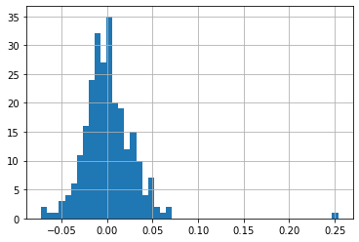
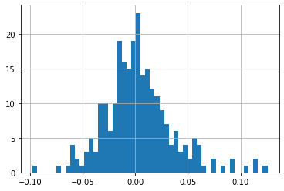
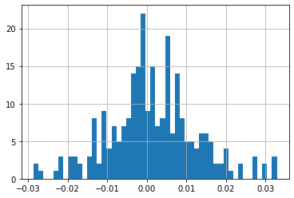
Sharpe Ratio’s used to run Monte Carlo Simulations on each portfolio
With a sample size of 5000 trials
Stock balance weights of 1/3 each
Expected return and volatility timeframe for upcoming 12 months
Sharpe Ratio for all three portfolios visualized as a bar graph distribution, showing us a varying risk level for our return as the bars are centered around the zero value along the x-axis
Tropical Paradise
Gaming The System
Making the World Go Around

Slide 19
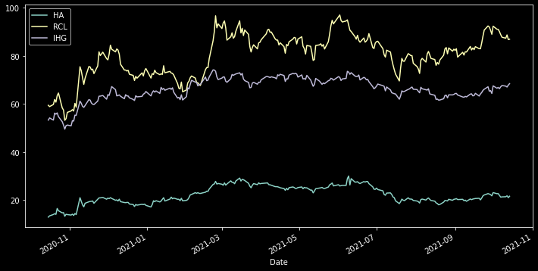
Visualization – Portfolio Stock Price Performance (Past 12 months)
Tropical Paradise:
Hawaiian Airlines (HA)
Royal Caribbean (RCL)
Intercontinental Hotels (IHG)

Slide 20
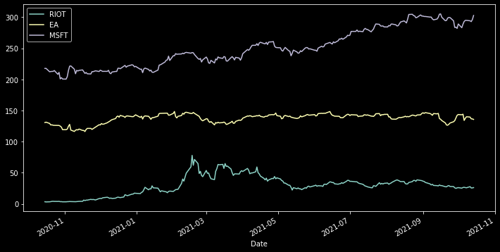
Visualization – Portfolio Stock Price Performance (Past 12 months) Cont.
Gaming the System:
Riot Blockchain (RIOT)
Electronic Arts Studios (EA)
Microsoft (MSFT)

Slide 21
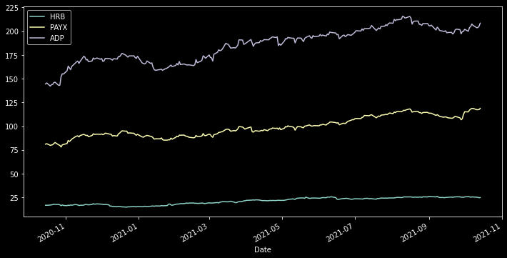
Visualization – Portfolio Stock Price Performance (Past 12 months) Cont.
Digital Paper:
H&R Block (HRB)
Paychex Inc. (PAYX)
Automatic Data Processing (ADP)
The Sharpe ratio bar graph tells us that the strong concentration around the zero-value of the x-axis indicates a moderate risk for this particular portfolio

Slide 22
Monte Carlo Simulation to Produce efficient Frontier Graph
The further along on the x-axis (volatility) the portfolio falls on, the higher the possibility is to land on the y-axis (expected return) will be
Simulates 5000 portfolios with, with each stock making up one third of the total weight
One can modify the weighing of the stocks in the portfolios to find the best frontier landing to calculate an excellent risk-to-reward ratio for the next year

Slide 23
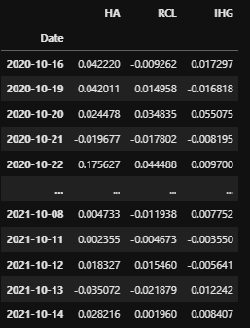
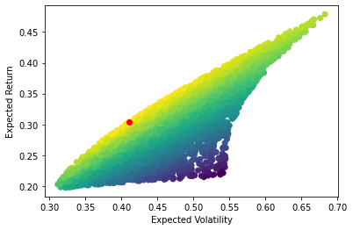
Tropical Paradise

Slide 24
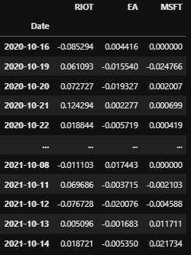
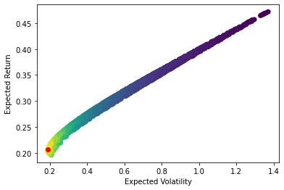
Gaming the System

Slide 25
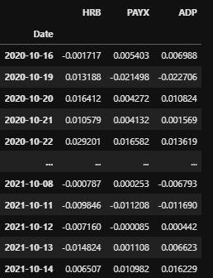
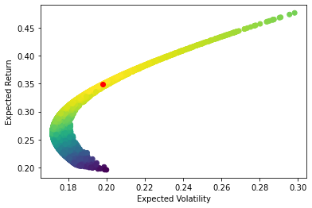
Making the World Go Around

Slide 26


Analyzing Our Findings
While the exercise did not allow us to add a stock scanner to find the most volatile stocks in real time by using certain themed-search parameters by using a data scraping method as we had originally planned, we found that we could improve on this stock selection method by revising the code to include said scanner in the future

Slide 27
Analysis and Benefit
We believe that by beginning the stock selection process with a common interest to the user, they will be more active in overseeing their selections. The use of the Sharpe Ratio calculations for each portfolio allows us to compare and modify selections if necessary. The Efficient Frontier graph that was produced by the Monte Carlo simulations gives us a glimpse of what the portfolios performance in terms of risk-to-reward balance could look like.

